Slide 1
Clusters in the Data
Question: Which Visualization? How to Report?

Slide 2
Description of presentation
Plotting each cluster in a separate sequence of 9 Topoplots, mostly for overview.
Time interval is from first significant cluster moment to the last, bins are equally spaced from cluster onset to cluster offset
Going from smallest cluster to largest cluster each for positive and negative
NOTE: This presentation was done with the contrast visible – occluded. In the paper, I will report the contrast occluded – visible, so negative and positive clusters will be switched.

Slide 3
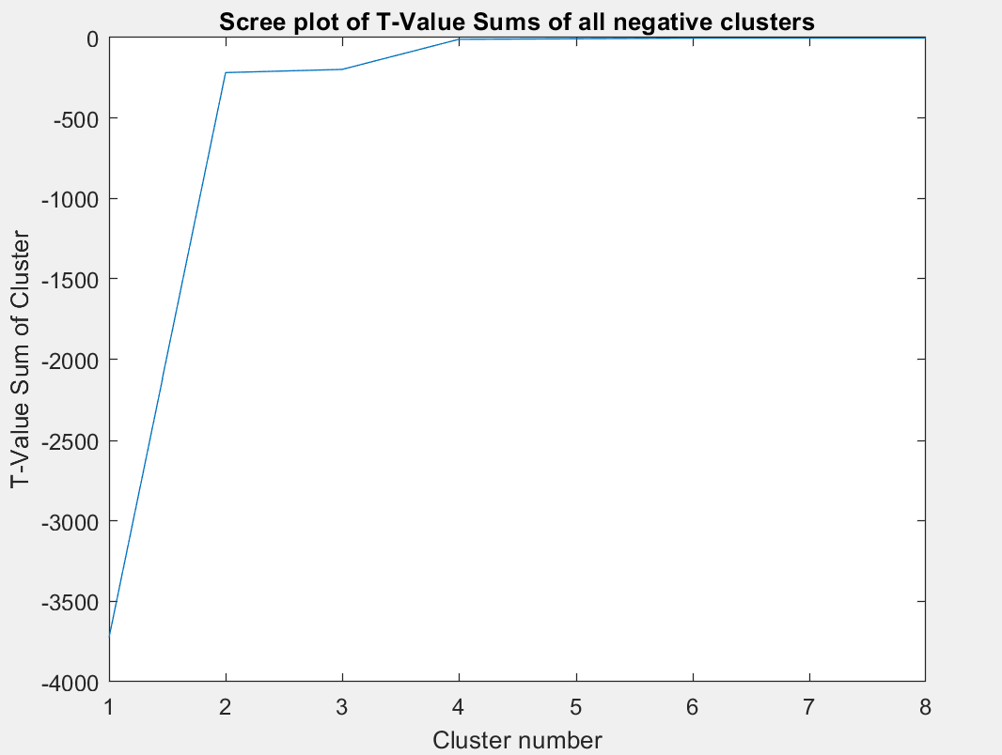
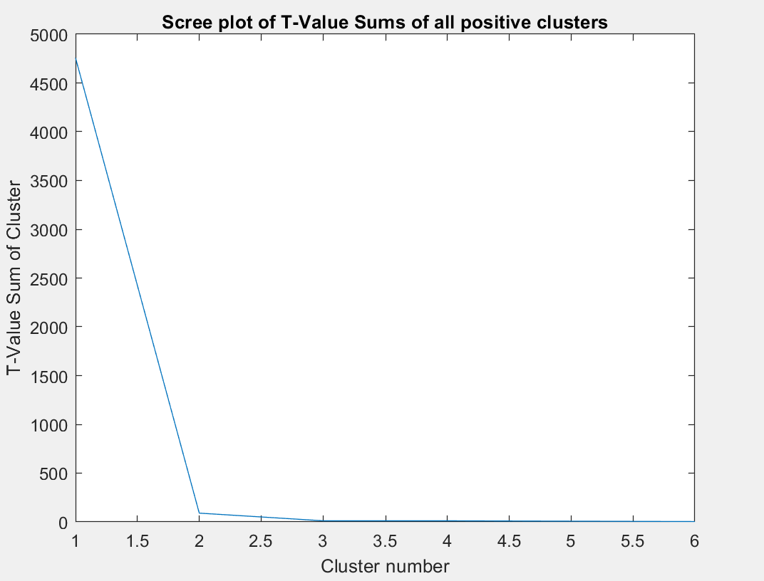
Scree Plots

Slide 4
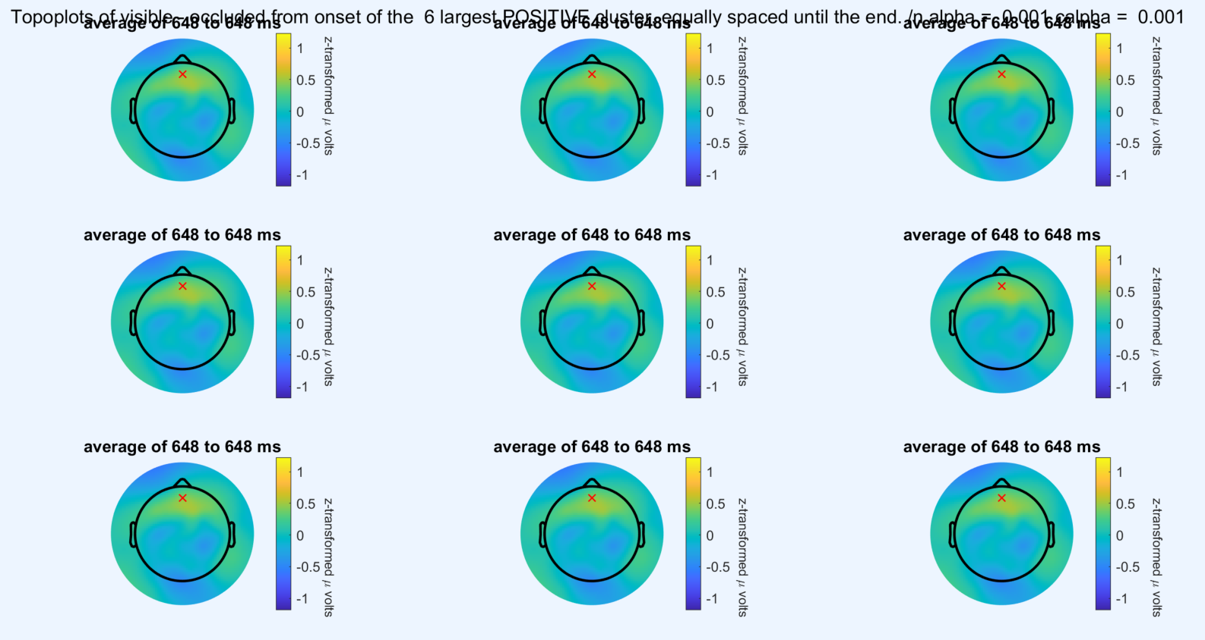
Topoplots Positive

Slide 5
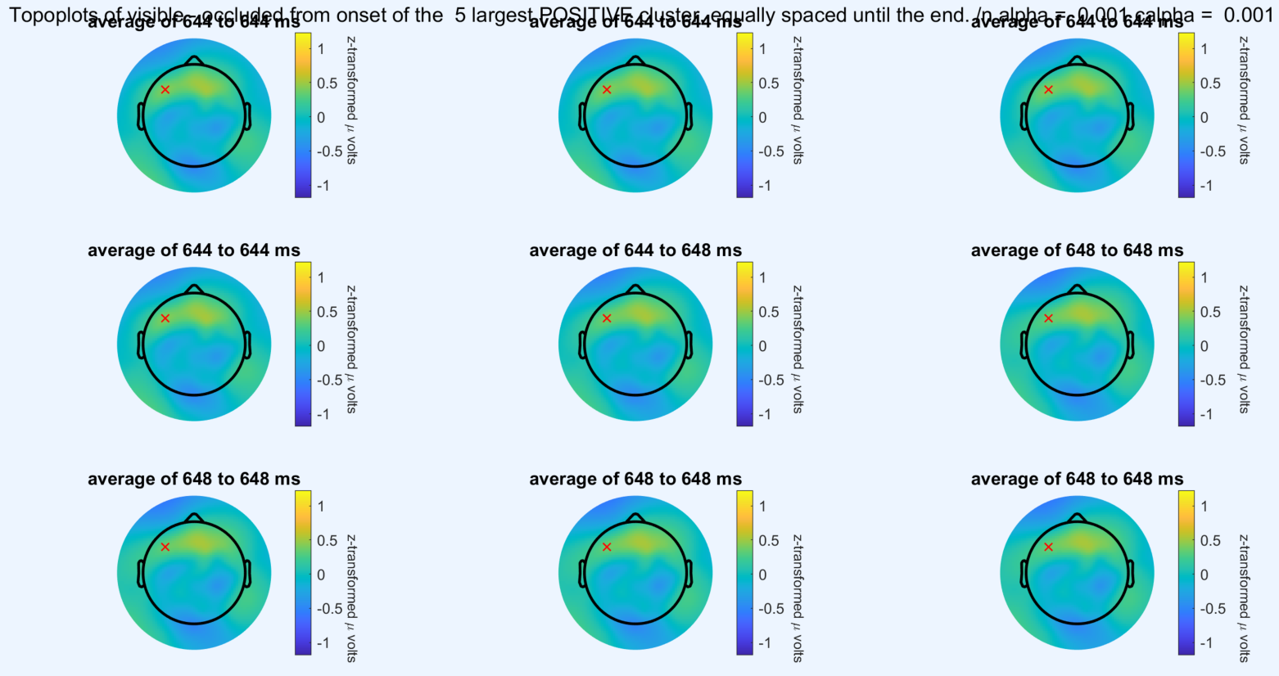
Topoplots Positive

Slide 6
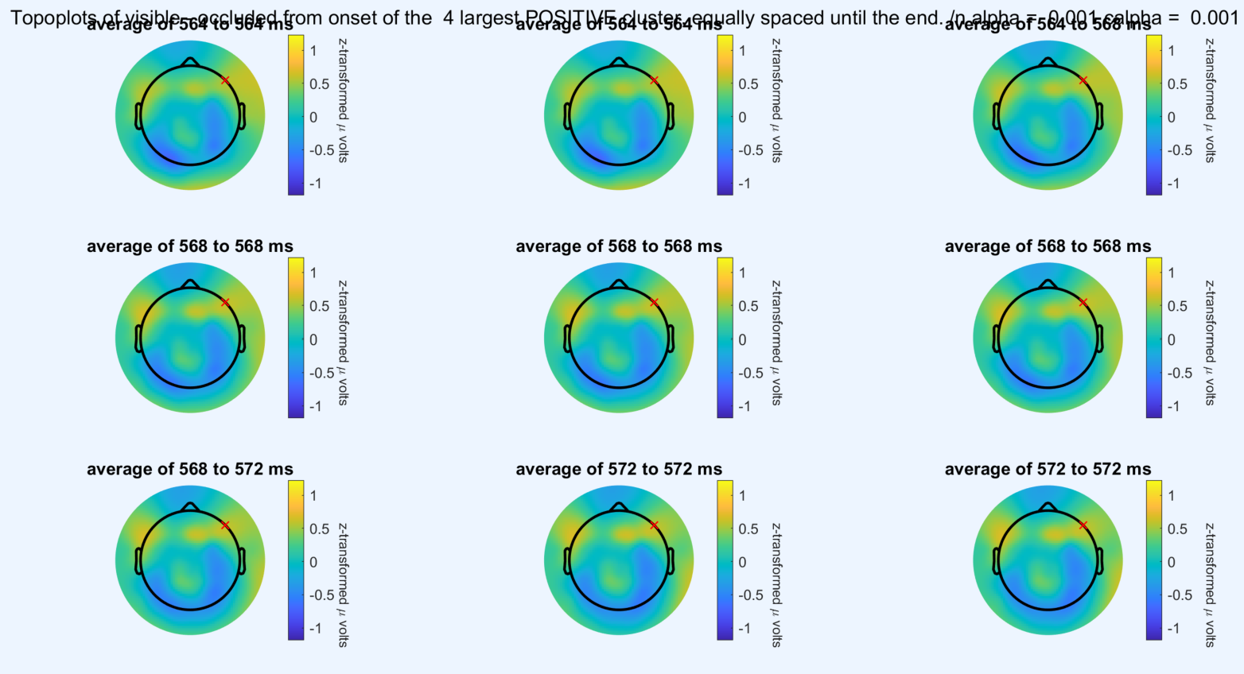
Topoplots Positive

Slide 7
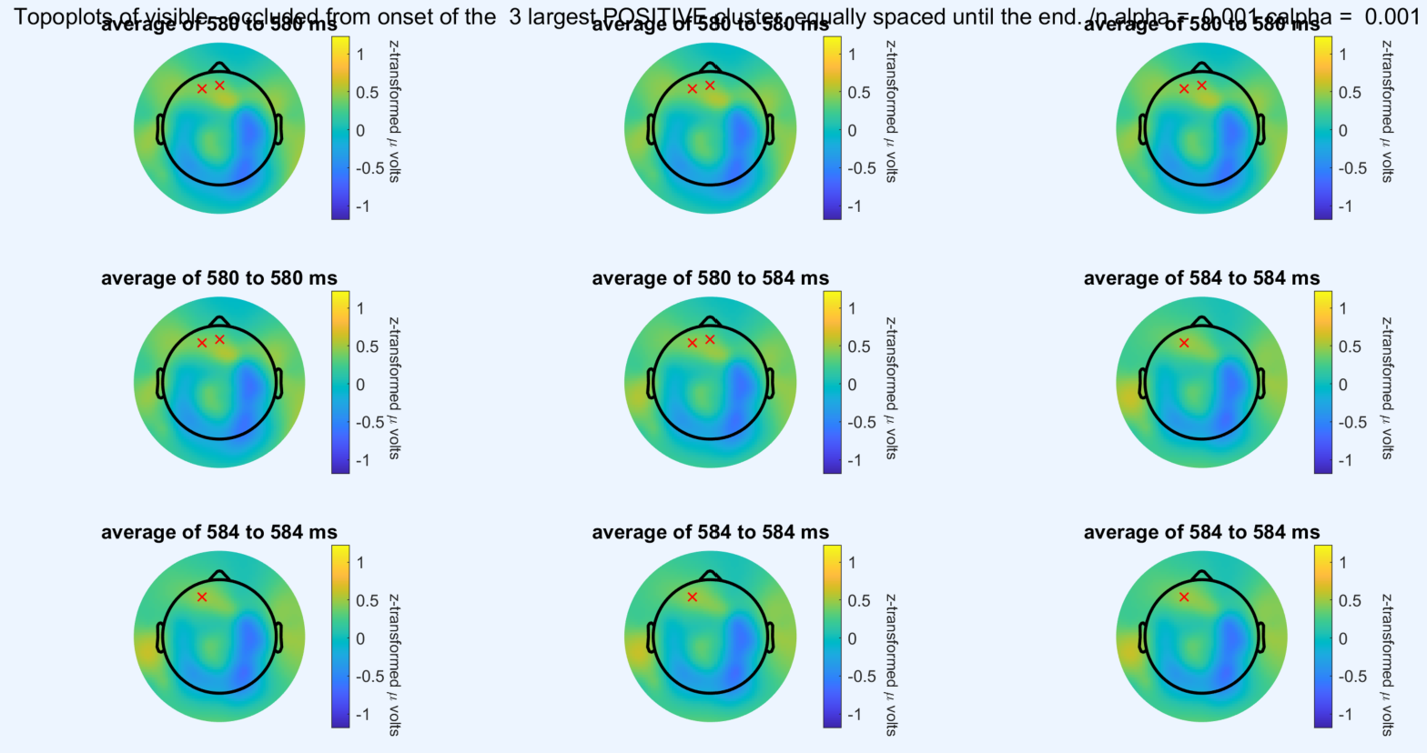
Topoplots Positive

Slide 8
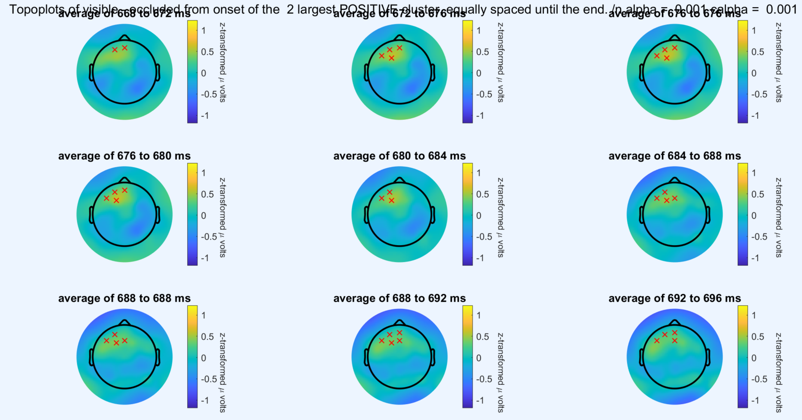
Topoplots Positive

Slide 9
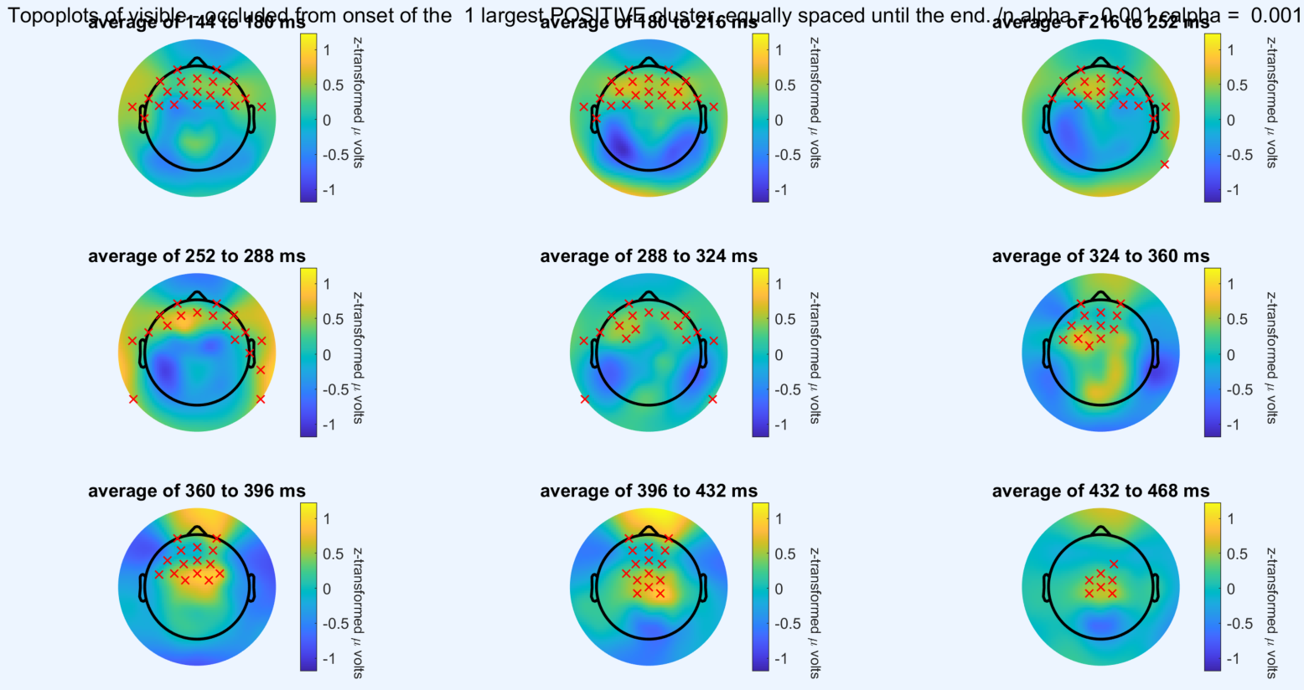
Topoplots Positive: Largest Cluster is 27.6 % of t-values

Slide 10
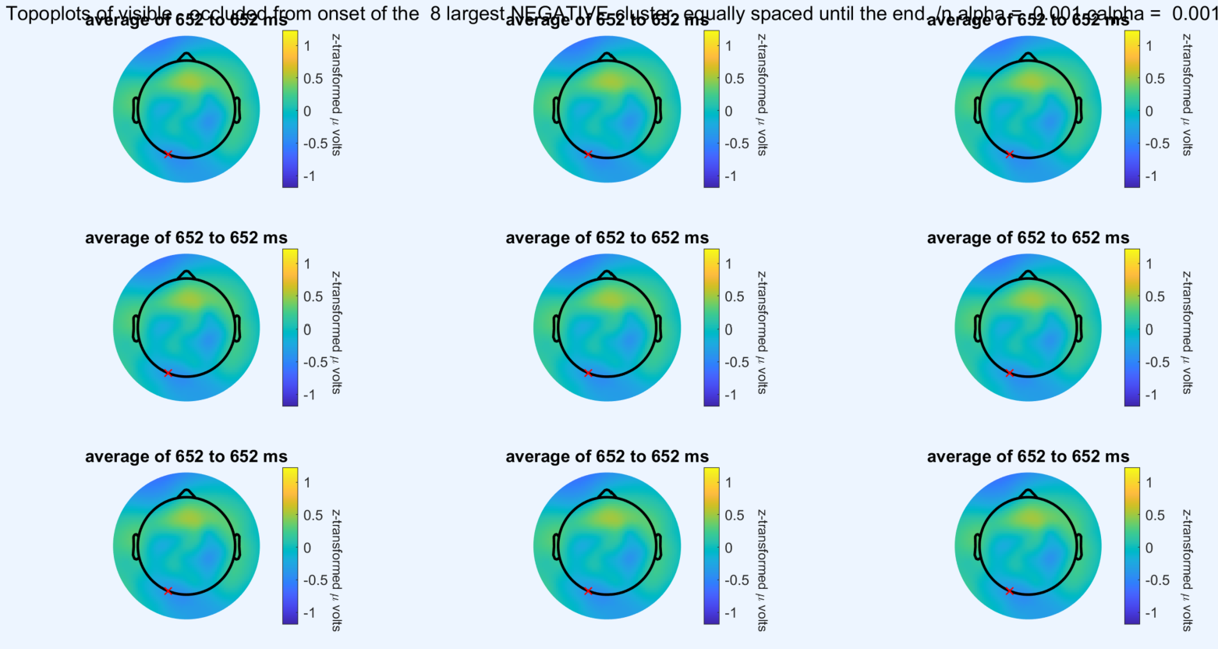
Topoplots Negative

Slide 11
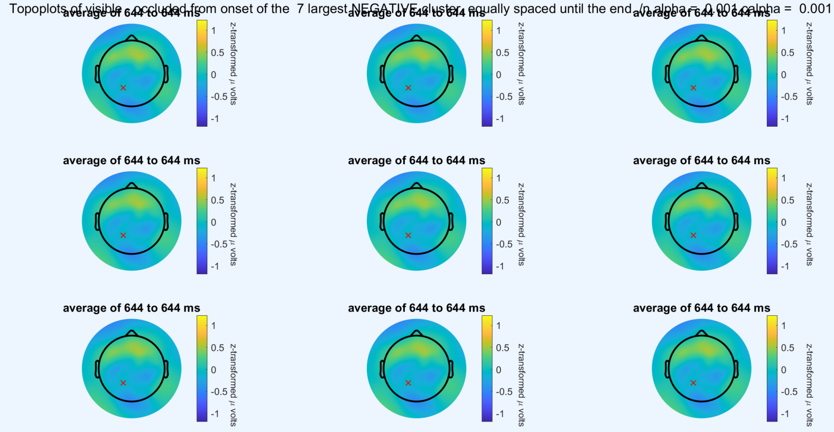
Topoplots Negative

Slide 12
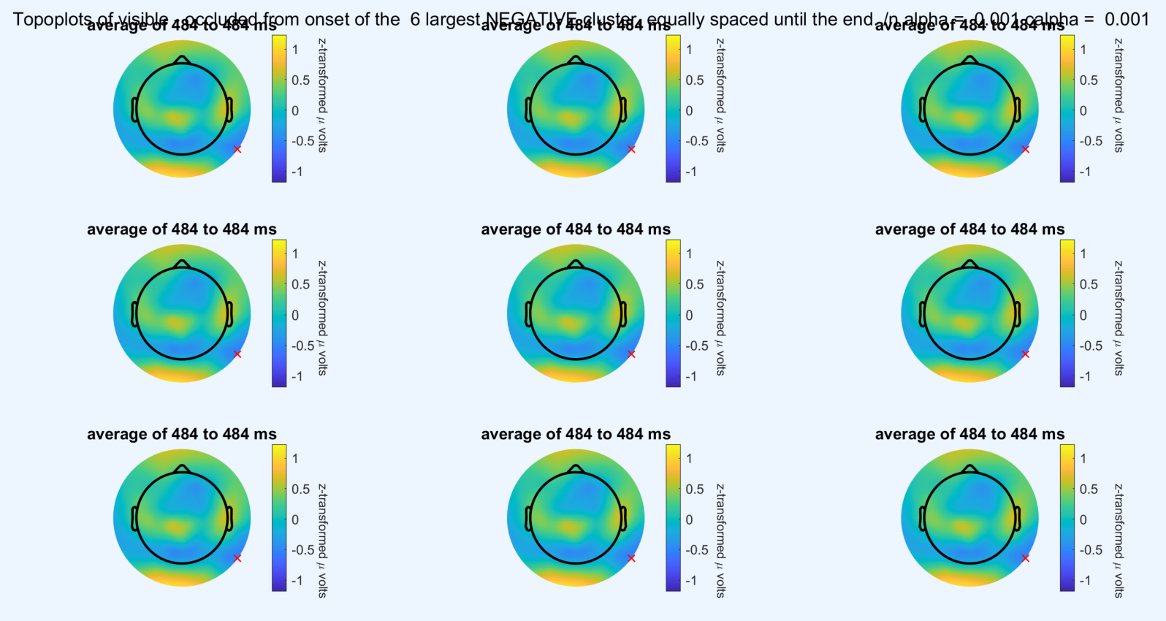
Topoplots Negative

Slide 13
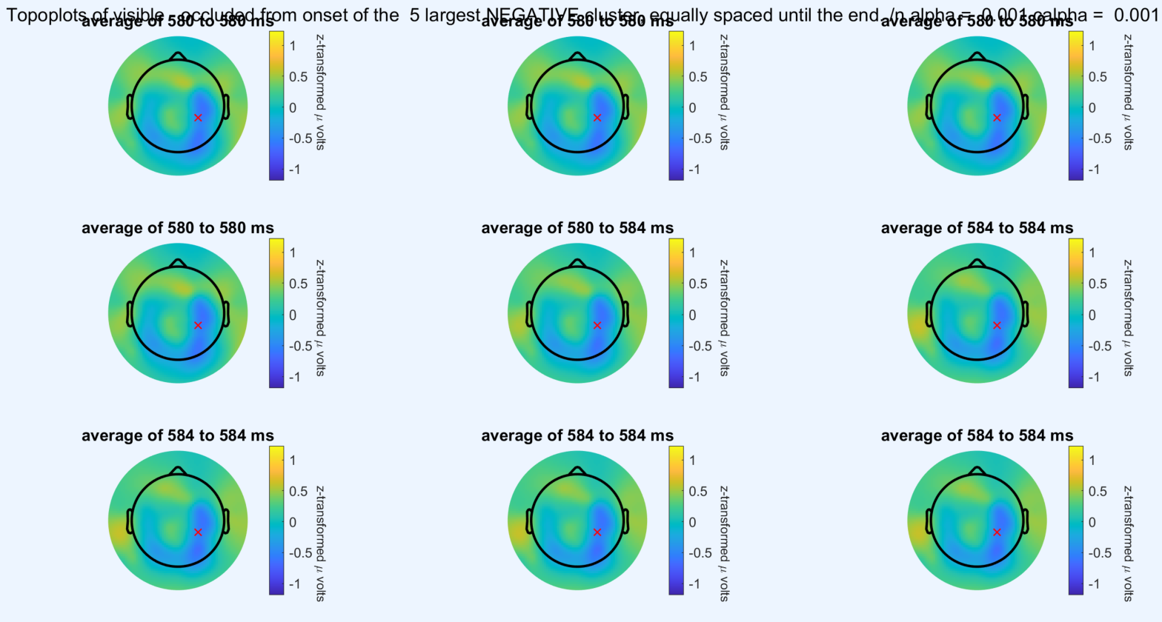
Topoplots Negative

Slide 14
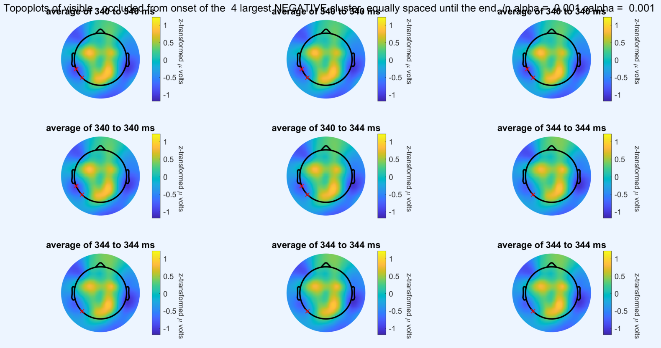
Topoplots Negative

Slide 15
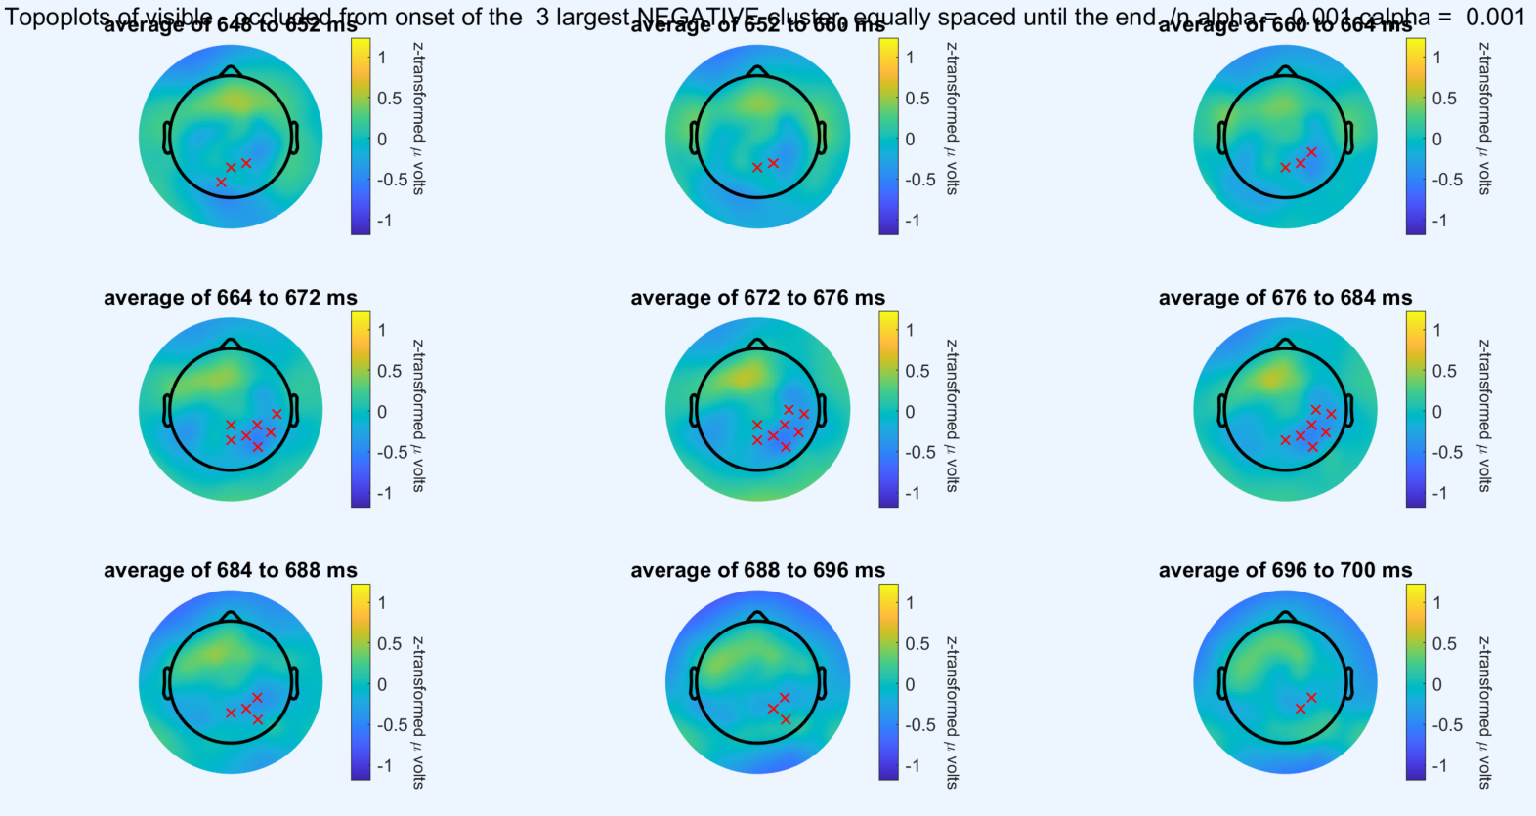
Topoplots Negative

Slide 16
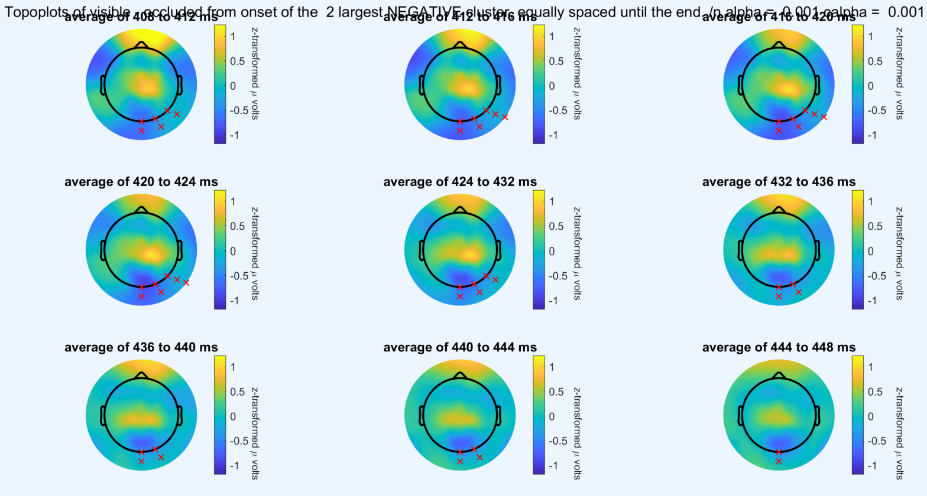
Topoplots Negative

Slide 17
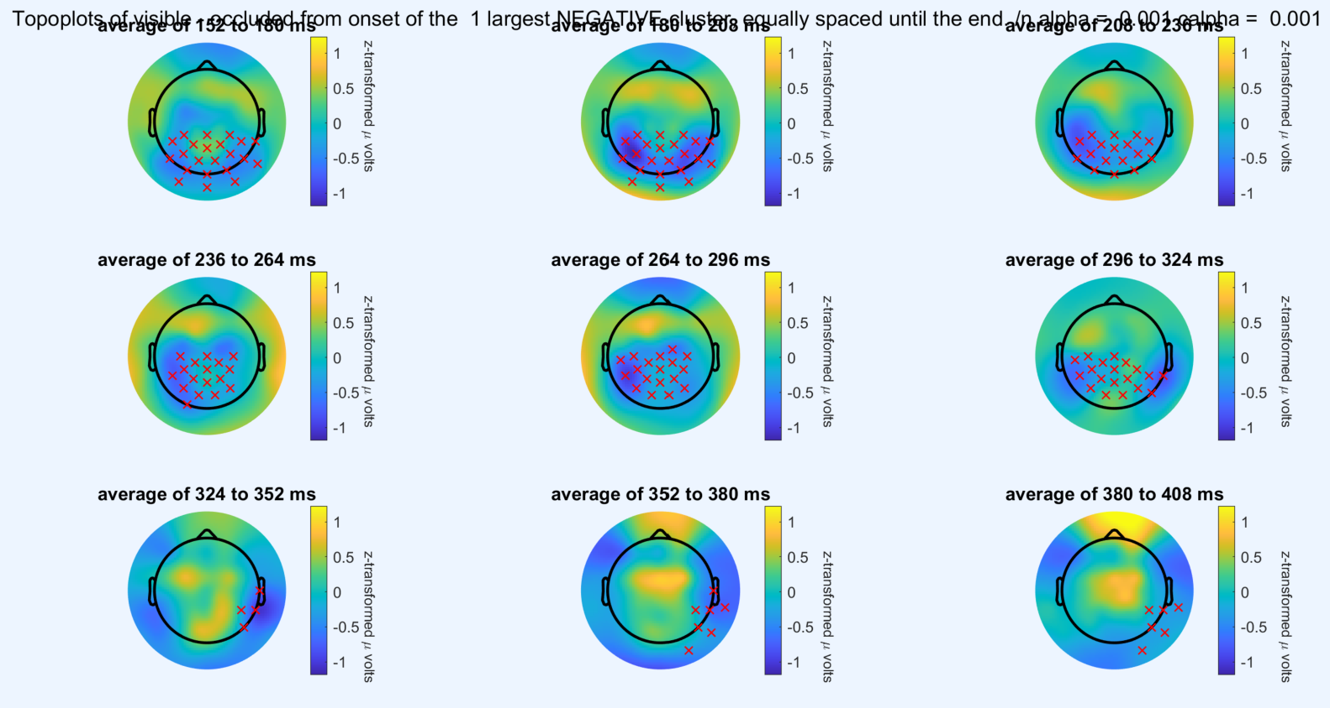
Topoplots Negative: Largest Cluster is 27.41 % of t-values

Slide 18
My Conclusion:
Only report largest negative/positive cluster
Reasoning: In order to decide which clusters are relevant to report, we summed up the t-value sums from all the significant clusters, separately for negative (sum of t-values: -4880.63) and positive (sum of t-values: 4171.12) clusters. We selected the cluster with the respectively largest summed t values, since this sum accounts for 89.31% of the total negative (t-value sum of largest cluster: -4756.62) respectively 97.46% of the total positive (t-value sum of largest cluster: - 3725.23) cluster t-value sums.
To avoid confusion: the images are sitll with visible – occluded but the text here is with occluded – visible, hence positive and negative are switched in the text as compared to the images. Paper images will of course be consistent!
TODO: Change binning again to equidistant (e.g. 30 ms each) and put both clusters (negative and positive) in the same plot with different colors

Slide 19
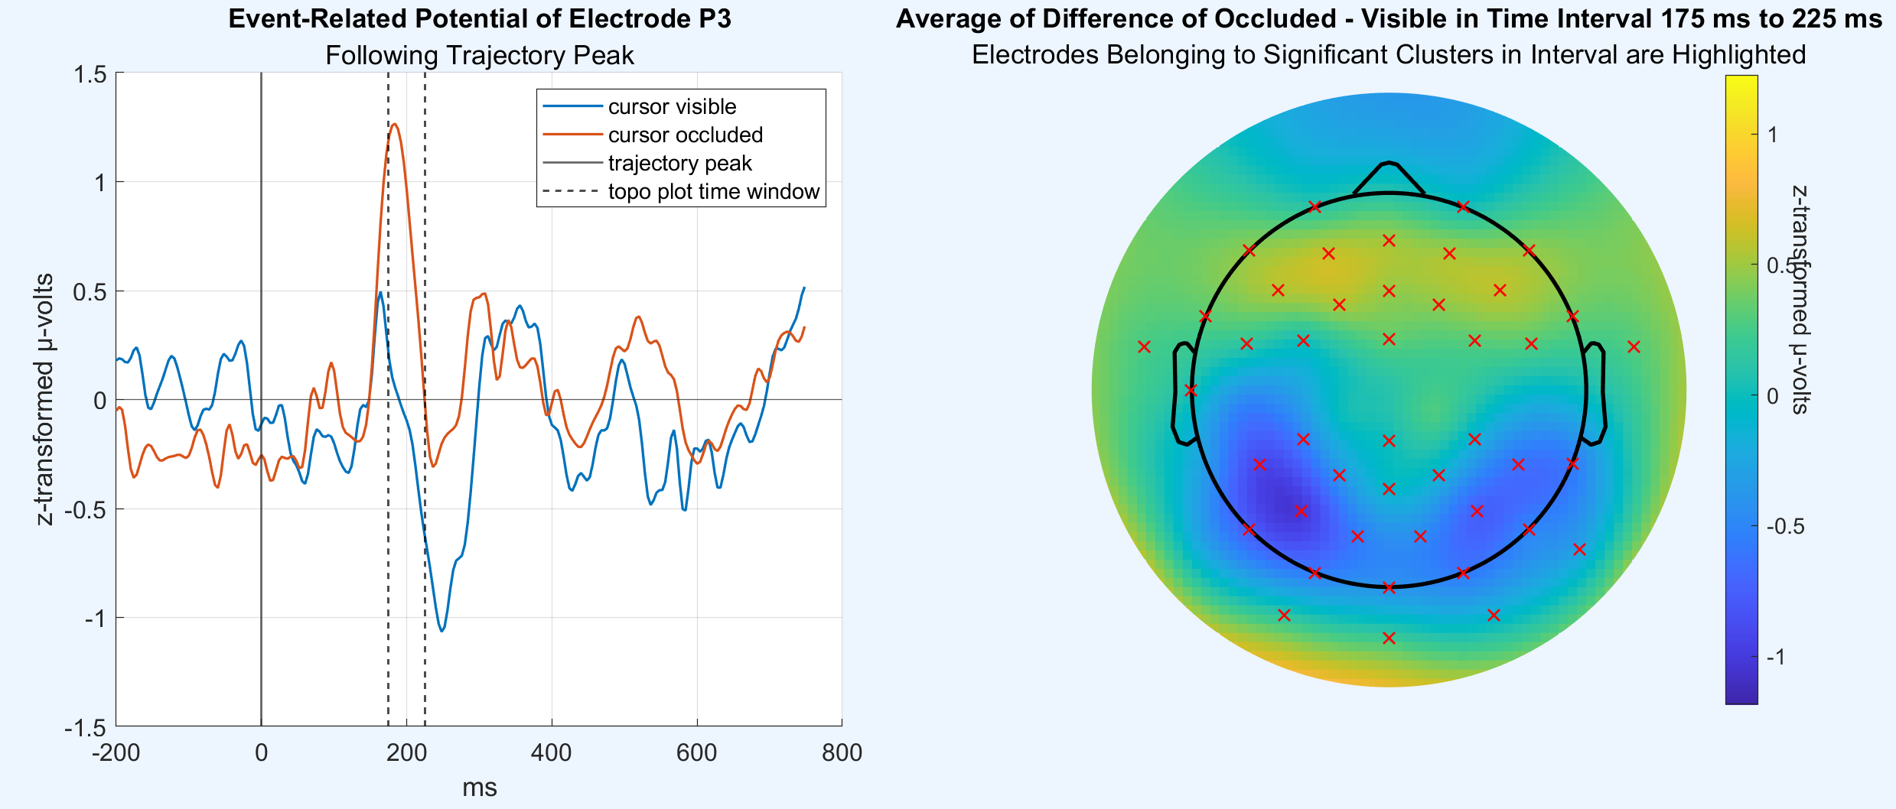
Alternative or Supplementary Visualization

